Slide 1
Decision Tree – Pros and Cons
Pros:
Trees can be displayed graphically, and are easily interpreted.
Human like decision making – decision trees mirror human decision-making than do the regression and classification approaches.
Cons:
Trees generally do not have the same level of predictive accuracy as some of the other regression and classification approaches.
A small change in the data can cause a large change in the final estimated tree.
Decision Trees suffer from high variance.
By using ensemble methods like bagging, random forests, and boosting, the predictive performance of trees can be substantially improved.

Slide 2
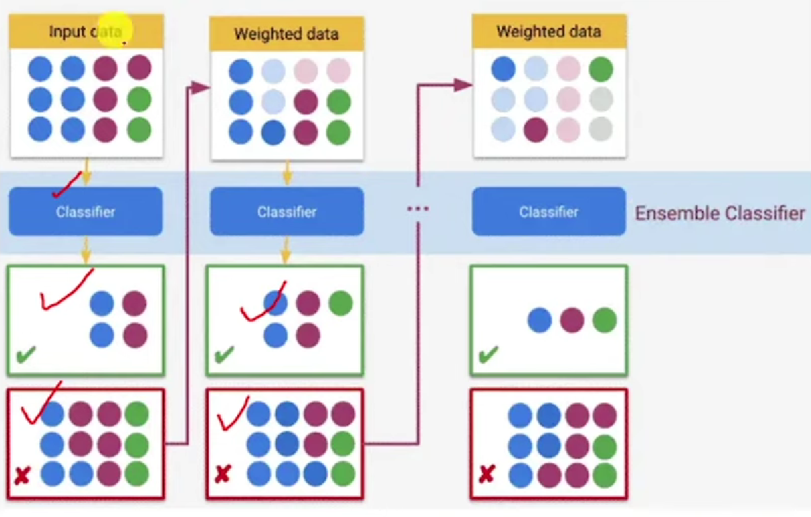
Boosting
Attempts to build a strong classifier from a set of weak classifiers.
Input data is divided into 2 sets- correctly classified data and incorrectly classified data. It then send only incorrectly classified data into the next round where it repats the process until majority is correctly classified dataset.

Slide 3
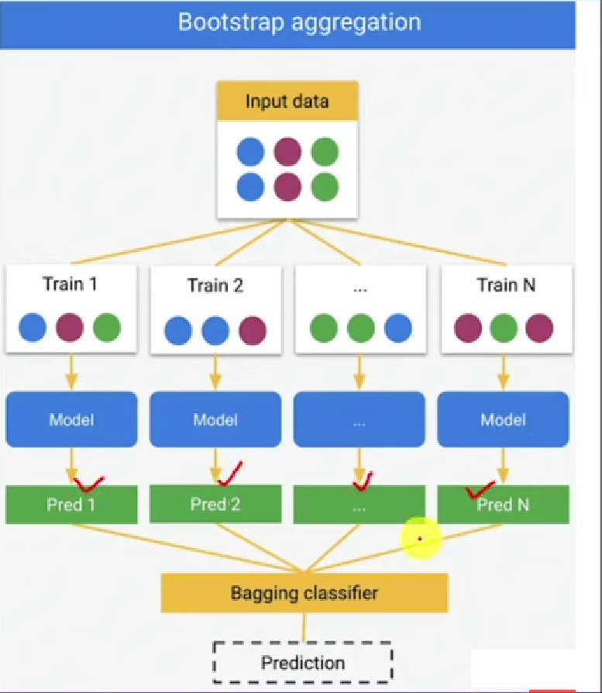
Bootstrap Aggregation - Bagging
Bootstrap aggregation, or bagging, is a general-purpose procedure for reducing the variance of a machine learning method
In this approach we generate n different bootstrapped training data sets from the given single input training dataset. Then train the model using each of the n bootstrapped training set in order to get a prediction with least variance.
Regression - Construct B regression trees using B bootstrapped training sets, and average the resulting predictions. Resulting trees are grown deep, and are not pruned. Hence each individual tree has high variance, but low bias. Averaging these B trees reduces the variance.
Classification – After the trees are modelled, for a given test observation, record the class predicted by each of the B trees, and take a majority vote for predicting the label of the test observation. Bagging can improve predictions for many regression methods, especially useful for decision trees.

Slide 4
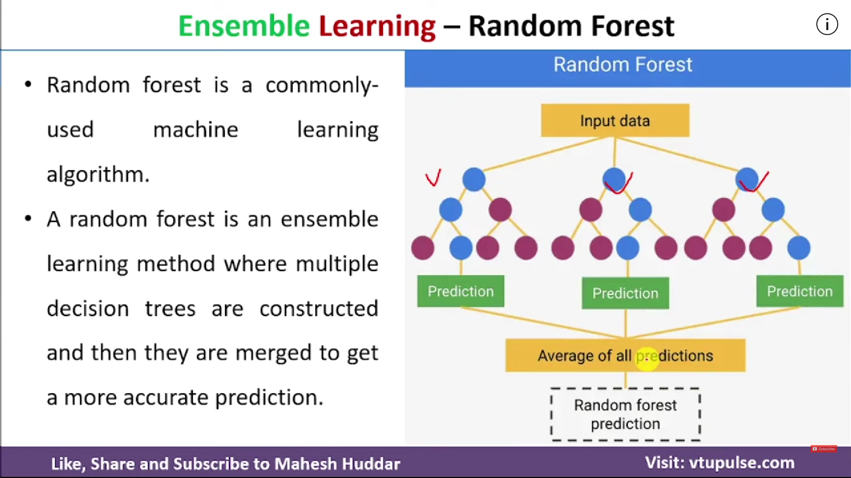
Random Forests
Random forests provide an improvement over bagged tress.
In bagging, a number of decision trees are build on bootstrapped training samples. But in random forests, if the no. of examples in the training set is N, take a sample of n examples at random but with replacement.

Slide 5
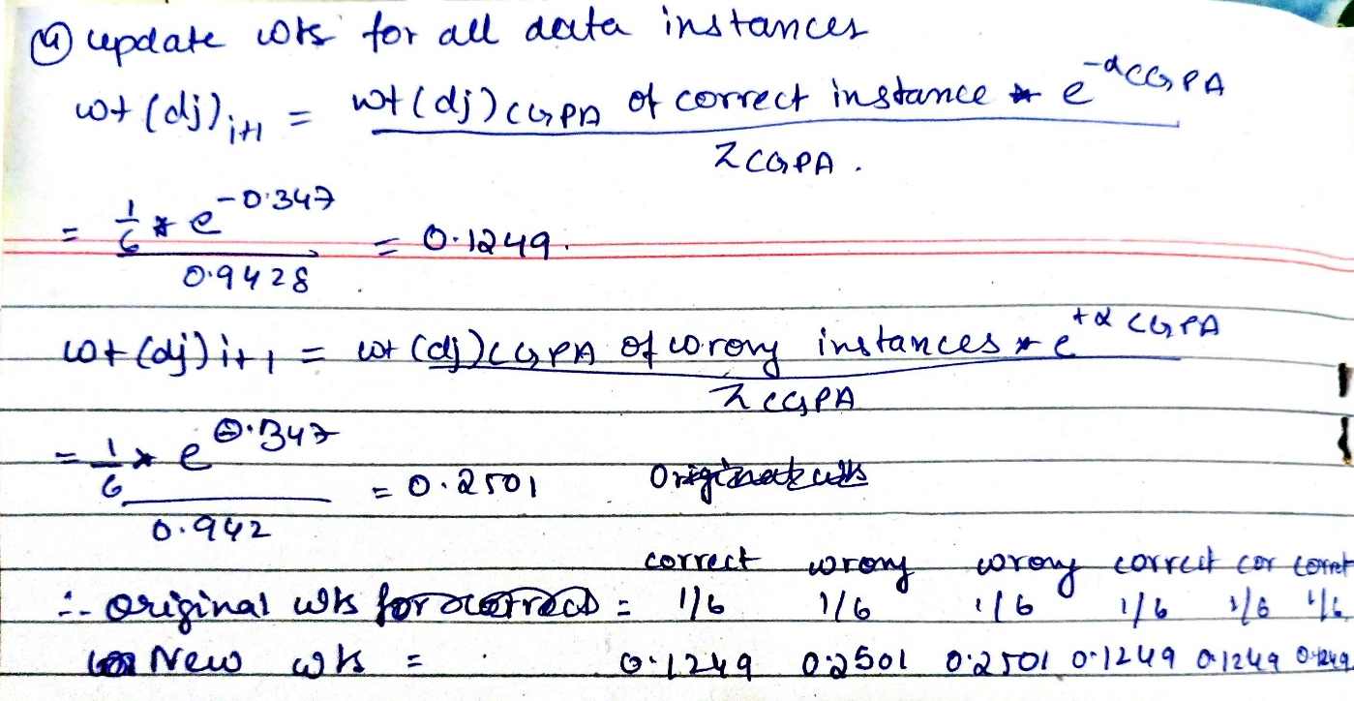
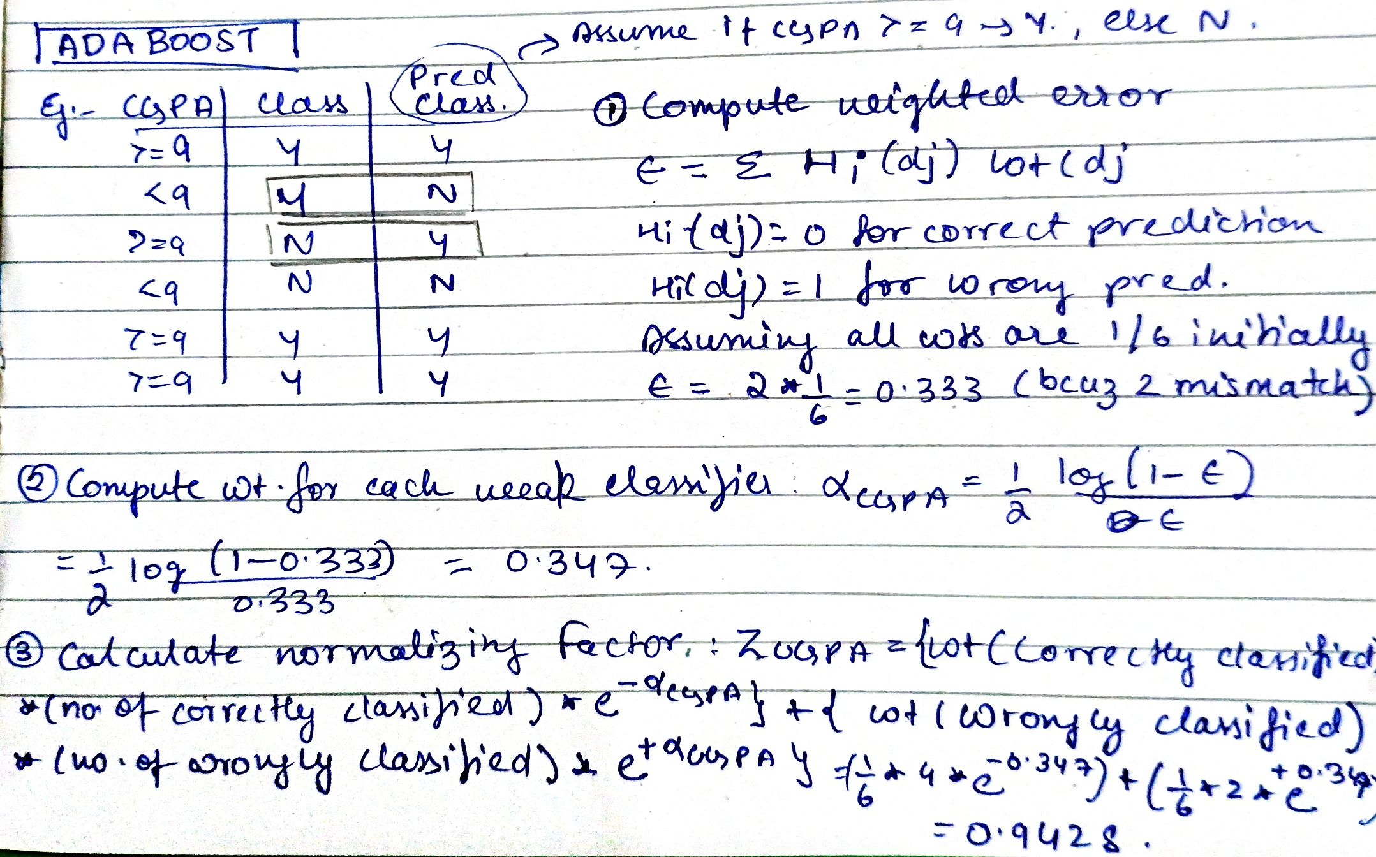
Adaboost
https://youtu.be/l3DzJBb3MaE?si=iqhdOFbBiieUnIRP

